Slide 1
Entertainer Data Analysis
Subtitle: Detailed Overview and Visualization Techniques
Name : Soham Jitendra Shevtekar
Class : TE
Branch : Computer Science And Design
College : K.K.Wagh College Of Engineering Nashik

Slide 2
Introduction
The dataset contains information about various entertainers, their gender, birth year, notable achievements, and other career-related details.
This presentation provides an in-depth analysis of a dataset comprising various entertainers. The analysis aims to uncover key insights related to demographics, career milestones, and notable achievements within the entertainment industry.

Slide 3
Data Overview
Entertainer: Name of the entertainer.
Gender: Gender of the entertainer.
Birth Year: Year of birth.
#1 Hit: Notable achievements or hit works.
Breakthrough: Significant breakthrough work.
Award Year: Year when the entertainer received a notable award.
Last Work: Year of the last significant work.
Year of Death: Year of death, if applicable.
Age: Current age or age at death.
Living Status: Indicates whether the entertainer is alive or deceased.

Slide 4
Purpose of the Analysis
To provide a comprehensive overview of the dataset.
To highlight key demographic information and career milestones.
To visualize the distribution of achievements and recognition among entertainers.
To identify notable trends and patterns that can inform further research or analysis.

Slide 5
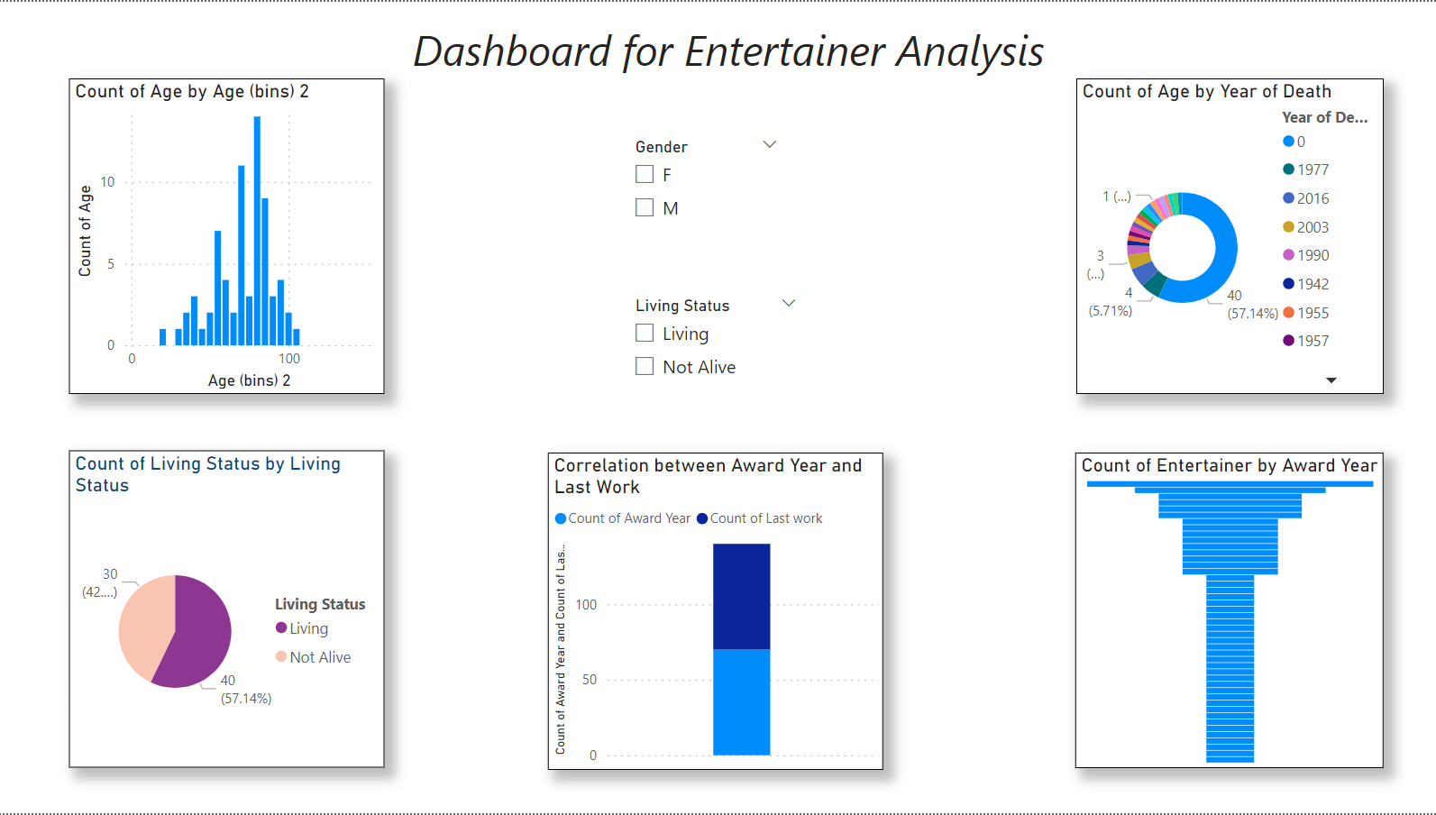
Dashboard

Slide 6
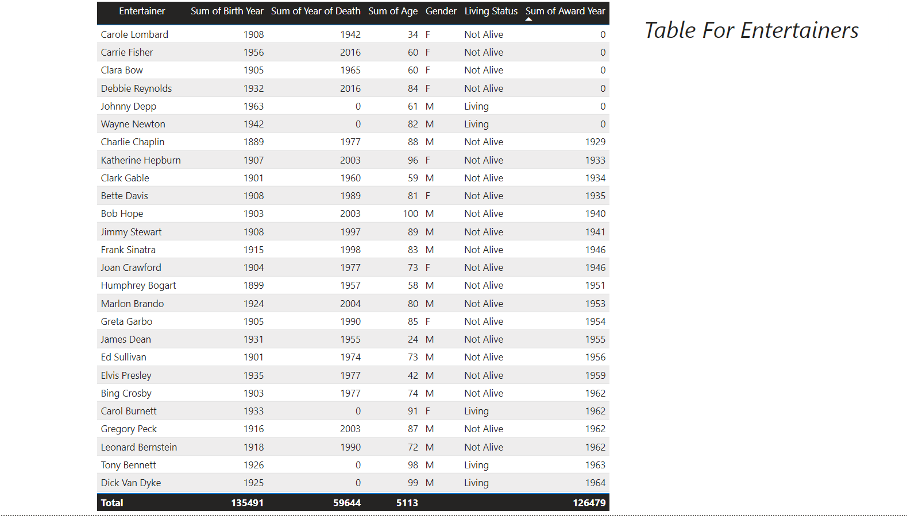
Table

Slide 7
Thank You

